Slide 1
COMPILER DESIGN By G. Srinivas Dept of Information Technology Aditya Engineering College(A) Surampalem.

Slide 2
Syllabus
UNIT-I
Overview of Language Processing: Language Processors, Structure of a Compiler.
Lexical Analysis: The Role of the Lexical Analyzer - Lexical Analysis Vs. Parsing, Tokens, Patterns and Lexemes, Lexical Errors, Regular Expressions, Regular Definitions, Recognition of Tokens, The Lexical-Analyzer Generator Lex.
UNIT –II
Syntax Analysis:
The Role of the Parser, Context Free Grammars- Derivations, Parse Trees, Ambiguity, Left Recursion, Left Factoring, Classification of Parsing Techniques.
Top-Down Parsing:
Brute-Force Parsing, Recursive-Descent Parsing, First and Follow, LL(1) Grammars, Non recursive Predictive Parsing, Error Recovery in Predictive Parsing.

Slide 3
Syllabus
UNIT-III
Bottom-Up Parsing:
Reductions, Handle Pruning, Shift-Reduce Parsing, Why LR Parsers, The LR-Parsing Algorithm, Constructing SLR-Parsing Tables, More Powerful LR Parses - Construction of CLR(1), LALR Parsing Tables, Using Ambiguous Grammars.
UNIT-IV
Semantic Analysis:
Syntax-Directed Definitions, Evaluation Orders for SDD’s, Syntax Directed Translation.
Intermediate Code Generation: Three Address Code – Addresses and Instructions, Quadruples, Triples, Abstract Syntax Trees, Type Checker - Type Expressions, Type Conversion.
Runtime Environments:
Storage Organization, Stack Allocation of Space, Storage Allocation Strategies – Static Allocation, Stack Allocation and Heap Allocation.

Slide 4
Syllabus
UNIT-V
Code Optimization:
Basic Blocks & Flow Graphs, Machine-Independent Optimizations – The Principal Sources of Optimization: Common Subexpression Elimination, Copy Propagation, Dead-Code Elimination, Code Motion, Induction Variables and Reduction in Strength, DAG Representation.
Code Generation:
Issues in the Design of a Code Generator, Object Code Forms, The Target Language, A Simple Code Generator, Machine-dependent Optimizations: Peephole Optimization, Register Allocation and Assignment.
Text Books:
1. Compilers, Principles Techniques and Tools. Alfred V Aho, Monical S. Lam, Ravi Sethi Jeffery D. Ullman, 2nd Edition, Pearson, 2007

Slide 6
Languages
Low Level Language
-Machine Language
-Assembly Language
High Level Language

Slide 7
Language Translator
Translates a program written in one (Source) language to its equivalent program in other (Target) language.
The Source program is a high level language where as the Target language can be any thing from the machine language of a target machine.

Slide 8
Translators
Assembler
Compiler
Interpreter

Slide 9
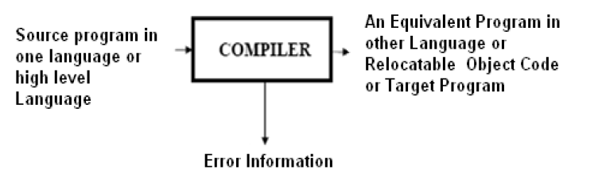

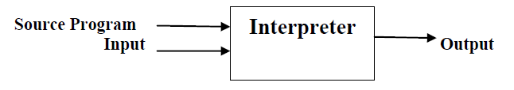
Compiler:
Interpreter:

Slide 10
Compiler vs Interpreter
Compiler Interpreter
1) Compiler scans entire high level language 1) Interpreter scans line by line.
at once.
2) If the source program is error free then 2) If the source program is error free
compiler generates the object program. then interpreter executes program.
3) Object program execution is not carried 3) Object program execution is carried
out by compiler. out by interpreter.
4) Compiler takes less time. 4) It takes more time.
5) It occupies more space. 5) Less space
6) Compilers can be implemented easily 6) Implementation of interpreter is not
in any programming language. a easy task.
Eg., C,C++,Fortran,pascal,ada etc., Eg.,python,lisp,prolog etc.,

Slide 11
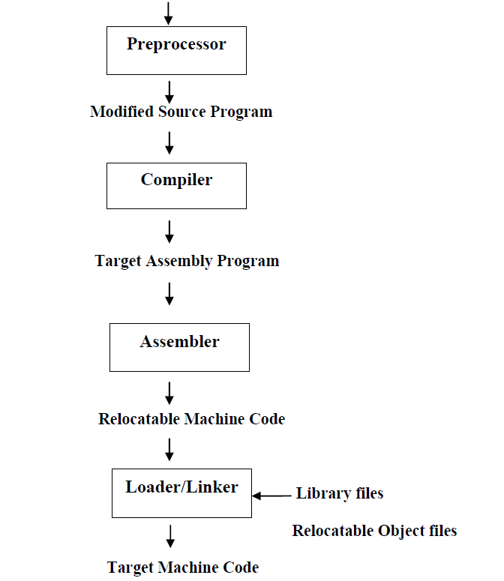
Language Processing System

Slide 12
Phases(Structure) of compiler
The Phases of compiler divided in to two parts, first three phases we are calling as analysis part remaining three calling as synthesis part.
Each phase transforms the source program from one representation into another representation.
They communicate with error handlers and the symbol table.

Slide 13
Lexical Analyzer
Lexical Analyzer reads the source program character by character and returns the tokens of the source program.
A token describes a pattern of characters having same meaning in the source program. (such as identifiers, operators, keywords, numbers, delimeters and so on)
Ex: newval := oldval + 12 => tokens: newval identifier
:= assignment operator
oldval identifier
+ add operator
12 a number
Puts information about identifiers into the symbol table.
Regular expressions are used to describe tokens (lexical constructs).
A (Deterministic) Finite State Automaton can be used in the implementation of a lexical analyzer.

Slide 14
Syntax Analyzer
A Syntax Analyzer creates the syntactic structure (generally a parse tree) of the given program.
A syntax analyzer is also called as a parser.
A parse tree describes a syntactic structure.
In a parse tree,
-All operands are at leaves.
-All interior nodes are represented as operators.
The syntax of a language is specified by a context free grammar (CFG).

Slide 15
Semantic Analyzer
A semantic analyzer checks the source program for semantic errors and collects the type information for the code generation.
Type-checking is an important part of semantic analyzer.
Context-free grammars used in the syntax analysis are integrated with attributes (semantic rules)
-the result is a syntax-directed translation,
-Attribute grammars

Slide 16
Intermediate Code Generation
A compiler may produce an explicit intermediate codes representing the source program.
These intermediate codes are generally machine (architecture independent). But the level of intermediate codes is close to the level of machine codes.
Properties of IR:
-Easy to produce
-Easy to translate into the target program
IR can be in following forms:
Syntax trees Postfix notation Three address statements
Properties of three address statements:
-At most one operator in addition to an assignment operator
-Must generate temporary names to hold the value computed at each instruction
-Some instructions have fewer than three operands

Slide 17
Code Optimization
The code optimizer optimizes the code produced by the intermediate code generator in the terms of time and space.
Removes unwanted or repeated instructions from intermediate code.

Slide 18
Code Generation
Produces the target language in a specific architecture.
The target program is normally a relocatable object file containing the machine code or assembly code.
Intermediate instructions are each translated into a sequence of machine instructions that perform the same task.

Slide 19
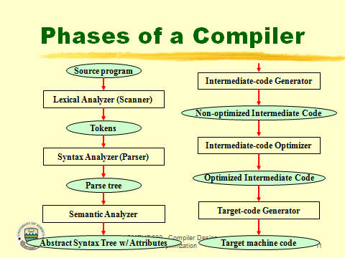

Slide 20
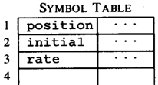




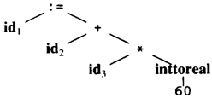
The Structure of a Compiler
Code Generator
[Intermediate Code Generator]
Scanner [Lexical Analyzer]
Tokens
Code Optimizer
Parser [Syntax Analyzer]
Parse tree
Code Genrator
Semantic Process [Semantic analyzer]

Slide 21
The role of lexical analyzer
token
Source
program
Lexical Analyzer
Parser
To semantic
analysis
getNextToken
Symbol
table

Slide 22
Why to separate Lexical Analysis and Parsing
Simplicity of design
Improving compiler efficiency
Enhancing compiler portability

Slide 23
Functions of Lexical Analyzer
Produces Stream of tokens.
It communicates with symbol table which stores the information about identifiers, constants occurred in the input.
Eliminates blank spaces and comments.
It keeps track of line numbers.
It reports the errors while generating the tokens.

Slide 24
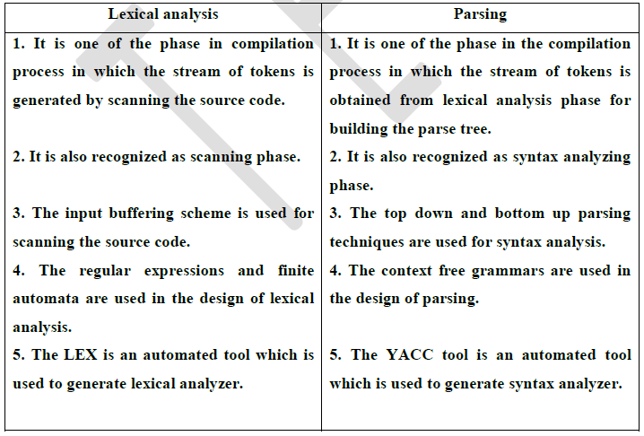
Lexical Analysis Vs. Parsing
Output
Also recognized as
Techniques used
Design
Tools used

Slide 25
Tokens, Patterns and Lexemes
Token is a sequence of characters having a collective meaning. It is generated when lexeme is matched against pattern
Pattern: The rule associated with each set of strings is called pattern.
or
A pattern is a rule describing the set of lexemes that can represent a particular token in the source program.
A lexeme is a sequence of characters in the source program that matches the pattern for a token

Slide 26
Example
Token
Sample Lexemes
Informal Description of Pattern
const
if
relation
id
num
literal
const
if
<, <=, =, < >, >, >=
pi, count, D2
3.1416, 0, 6.02E23
“core dumped”
const
if
< or <= or = or < > or >= or >
letter followed by letters and digits
any numeric constant
any characters between “ and “ except “
Actual values are critical.
Info is :
1.Stored in symbol table
2.Returned to parser
Classifies Pattern

Slide 27
Lexical Errors
Appearance of illegal characters.
Unmatched string.
Exceeding the length of identifier or numeric constants.
Some errors are out of power of lexical analyzer to recognize:
fi (a == f(x)) …
However it may be able to recognize errors like:
d = 2r
Such errors are recognized when no pattern for tokens matches
a character sequence.

Slide 28
Regular Expressions
Regular expression over alphabet Σ
∅ is a regular expression.
ε is a regular expression.
For any a∈Σ, a is a regular expression.
If r₁ and r₂ are regular expressions, then
(r₁ + r₂) is a regular expression.
(r₁ ⋅ r₂) is a regular expression.
(r₁* ) is a regular expression.
Nothing else is a regular expression.

Slide 29
Regular Definitions
Regular definitions are in the form of
d₁ -> r₁
d₂ -> r₂
…
d_{n} -> r_{n}
where d_{i} is a distinct name and r_{i} is a regular expression.

Slide 30
Extensions
One or more instances: (r)+
Zero of one instances: r?
Character classes: [abc] or [a-z]
Example:
letter -> [A-Z a-z]
digit -> [0-9]

Slide 31
Recognition of tokens
Regular Definition for Pascal Identifier:
letter -> [A-Z a-z]
digit -> [0-9]
id -> letter(letter | digit)*
Regular Definition for Integer Constant(number):
digit -> [0-9]
Digits -> digit digit* or digit⁺

Slide 32
Regular Definition for Real Constant:
digit -> [0-9]
rc -> digit digit*. digit digit*
Regular Definition for White space:
delimiter -> (blank | tab | newline)
ws -> delimiter delimiter* or delimiter⁺

Slide 33
Regular Definition for Unsigned numbers in pascal: 2012, 34.50, 10.33E4, 1.98E-4 …….
digit -> [0-9]
Digits -> digit digit*
Fraction -> .digits | Ɛ (or)
Exponent ->(E(+|-|Ɛ)Digits) | Ɛ
num -> Digits Fraction Exponent
digit -> [0-9]
Digits -> digit⁺
Fraction -> (.digits)?
Exponent ->(E(+|-)?Digits)?
num -> Digits Fraction Exponent

Slide 34
Regular Definitions:
If -> if
Then -> then
Else -> else
Relop -> < | > | <= | >= | = | <>
Regular Definition for Comments:
letter -> [A-Z a-z]
digit -> [0-9]
delimiter -> (blank | tab | newline)
ws -> delimiter⁺
Comments -> //(letter | digit |@ | + | - | * | / | $ | , | ws )*

Slide 35
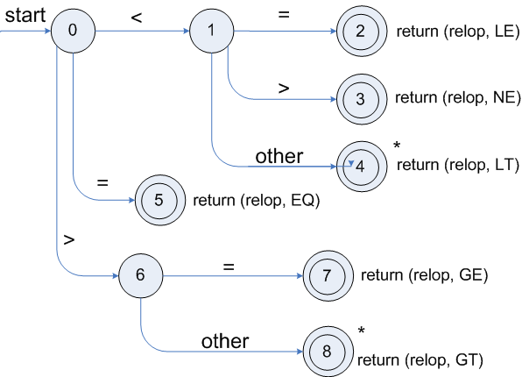
Transition Diagrams
Transition diagram for Relational Operators

Slide 36
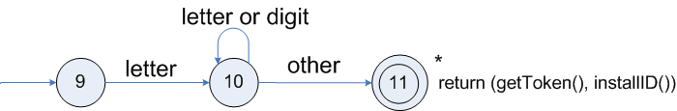
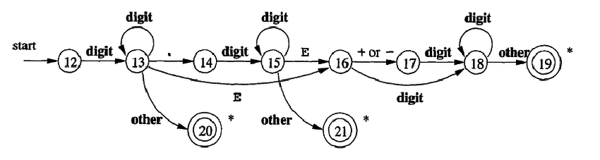
Transition diagram for an identifier
Transition diagram for unsigned numbers

Slide 37
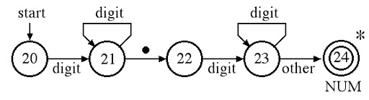
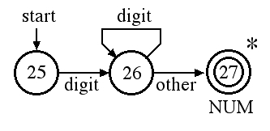
Transition diagram for real numbers
Transition diagram for number(integers)

Slide 38
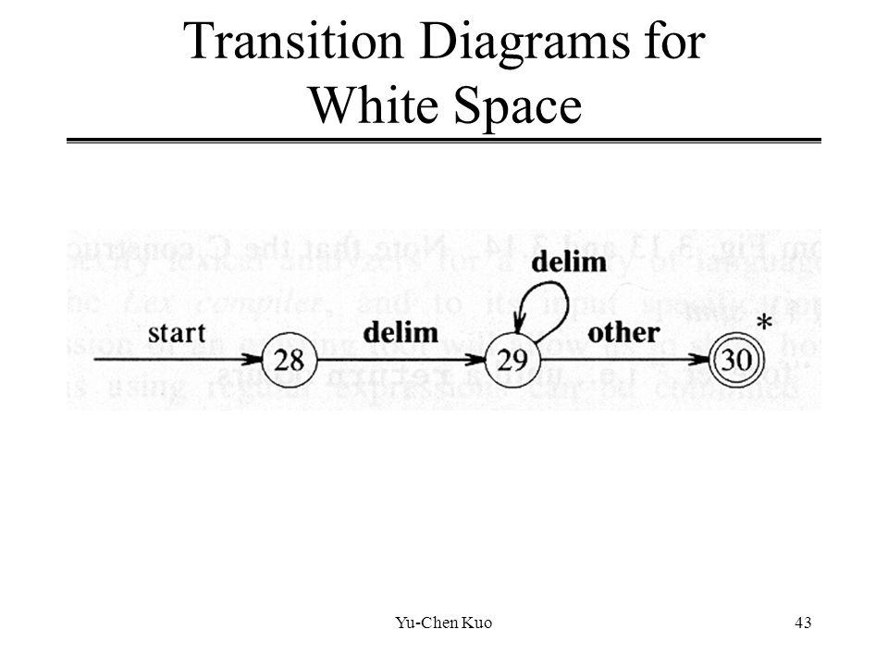

Slide 39
Lexical Analyzer Generator - Lex
Lex Source program
lex.l
Lexical Compiler
lex.yy.c
C
compiler
lex.yy.c
a.out
a.out
Sequence of tokens
Input stream

Slide 40
Structure of Lex Program
Lex Program is separated into three sections
declarations
%%
translation rules
%%
auxiliary functions
Pattern {Action}

Slide 41
Definitions or Declarations
Declarations of ordinary C variables ,constants and Libraries.
%{
#include <math.h>
#include <stdio.h>
#include <stdlib.h>
int count=0;
%}

Slide 42
Translation Rules
The form of rules are:
Pattern { action }
P1 { action 1 }
P2 { action 2 }
……
Pn { action n}
Example:
[0-9]+ { return(Integer); }
{DIGIT}+ { return(Integer); }

Slide 43
Auxillary Functions
We can use your Lex routines in the same ways you use routines in other programming languages (Create functions, identifiers) .
The section where main() is placed

Slide 44
Example 1
Lex program to recognize white spaces, identifier, keywords, number, operators in a program
%%
{ws} { }
if {printf(“Keyword”);}
then {printf(“Keyword”);}
else {printf(“Keyword”);}
{id} {printf(“Identifier”); }
{num} {printf(“Number”);}
{<|<=|>|>=|+} {printf(“operators”);}
%%
%{
#include<stdio.h>
%}
/* regular definitions*/
delim [ \t \n]
ws {delim}+
letter [A-Z|a-z]
digit [0-9]
id {letter}({letter}|{digit})*
num {digit}⁺
int main()
{
yylex();
}

Slide 45
Example 2
Lex program to count number of lines and words in a given program.
%{
#include<stdio.h>
int numWords = 0, numLines = 0;
%}
%%
\n {numLines++;}
[ \t \n] {numWords++;}
%%
int main()
{
yylex();
printf("%d\t%d\n", numWords, numLines);
}

Slide 46
END

